Slide 1
Architectural Tactics and Patterns
An architectural pattern is
is a package of design decisions that is found repeatedly in practice,
has known properties that permit reuse, and
describes a class of architectures
Patterns are found in practice, not invented, they are discovered.
There will never be a complete list of patterns. Patterns spontaneously emerge in reaction of environmental conditions, and as long as those conditions change, new patterns will emerge.
Architectural design seldom starts from first principles. Experienced architects typically think of creating an architecture as process of selecting, tailoring, and combining patterns
Patterns package tactics. Most of patterns consists of (are constructed from) several different tactics. Tactics are building blocks of design from which architectural patterns are created.
Multiple patterns can be used in architecture design of a complex system

Slide 2
Architectural Tactics and Patterns
Description of an architectural pattern:
Context: a recurring, common situation that gives rise to a problem.
Problem: a generalized problem that arises in the given context, including
problem outline and its variants
complementary or opposing forces
quality attributes that must be met
Solution: abstract description of the architectural structures that solve the problem by balancing many forces at work.
a set of element types (e.g. data repositories, processes, and objects)
a set of interaction mechanisms or connectors (e.g. method calls, events, and message bus)

Slide 3
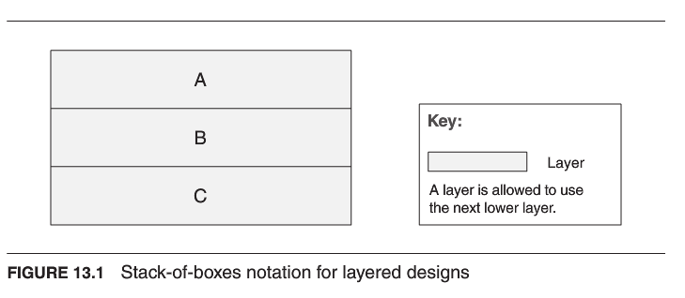
Module Patterns
Layered Pattern
Context: to develop and evolve portions of the system independently
Problem: modules can be developed and evolved separately with little interaction among the parts, supporting portability, modifiability, and reuse.
Solution

Slide 4
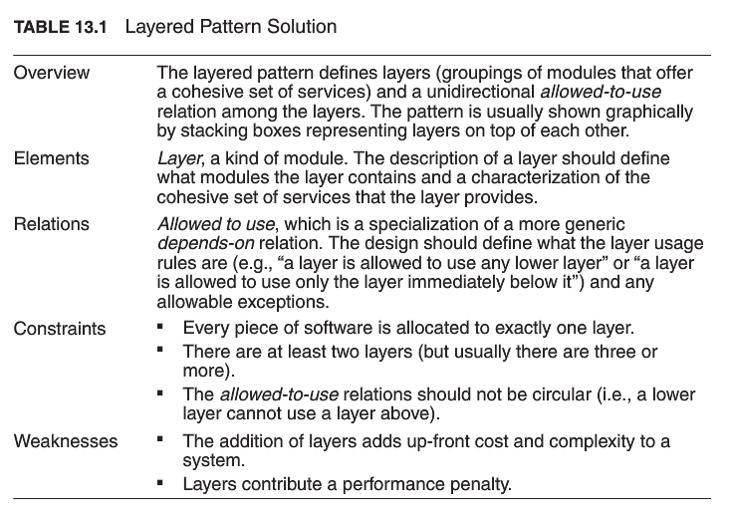
Module Patterns
Layered Pattern
Context: to develop and evolve portions of the system independently
Problem: modules can be developed and evolved separately with little interaction among the parts, supporting portability, modifiability, and reuse.
Solution

Slide 5
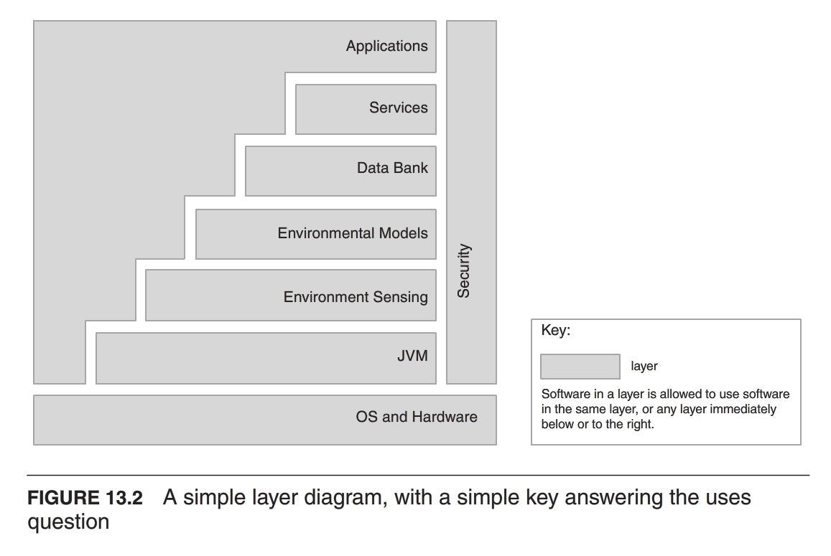
Module Patterns
Layered Pattern
Context: to develop and evolve portions of the system independently
Problem: modules can be developed and evolved separately with little interaction among the parts, supporting portability, modifiability, and reuse.
Solution

Slide 6
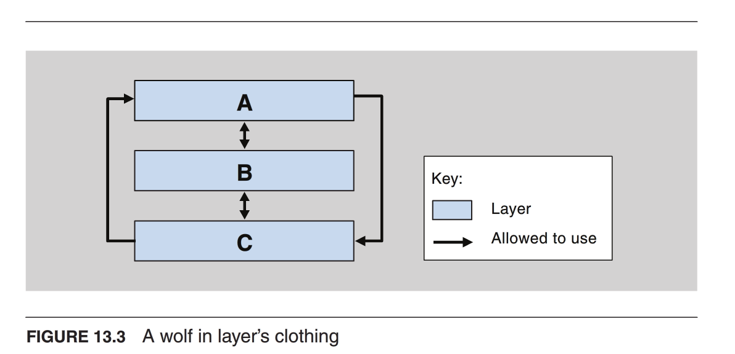
Module Patterns
Layered Pattern
Context: to develop and evolve portions of the system independently
Problem: modules can be developed and evolved separately with little interaction among the parts, supporting portability, modifiability, and reuse.
Solution

Slide 7
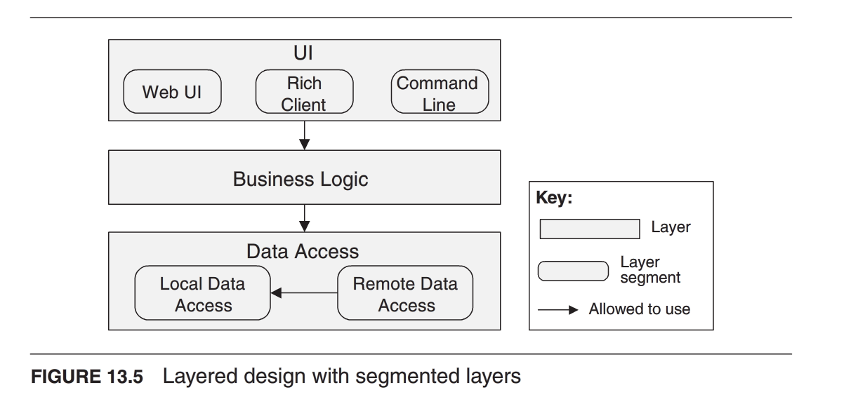
Module Patterns
Layered Pattern
Context: to develop and evolve portions of the system independently
Problem: modules can be developed and evolved separately with little interaction among the parts, supporting portability, modifiability, and reuse.
Solution

Slide 8
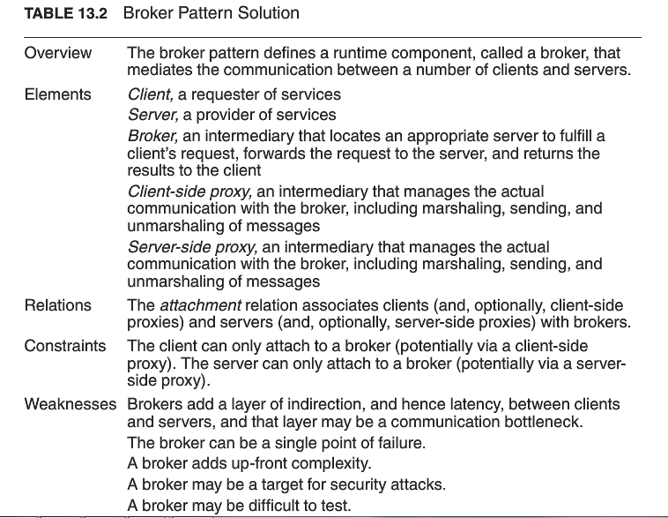
Component-and-Connector Patterns
Broker Pattern
Context: implementing systems with collaborative services: interoperation, connection, information exchange, and service availability.
Problem: How to structure distributed software so that service users do not need to know the nature and location of service providers, to make it easy to dynamically change the bindings between users and providers.
Solution

Slide 9
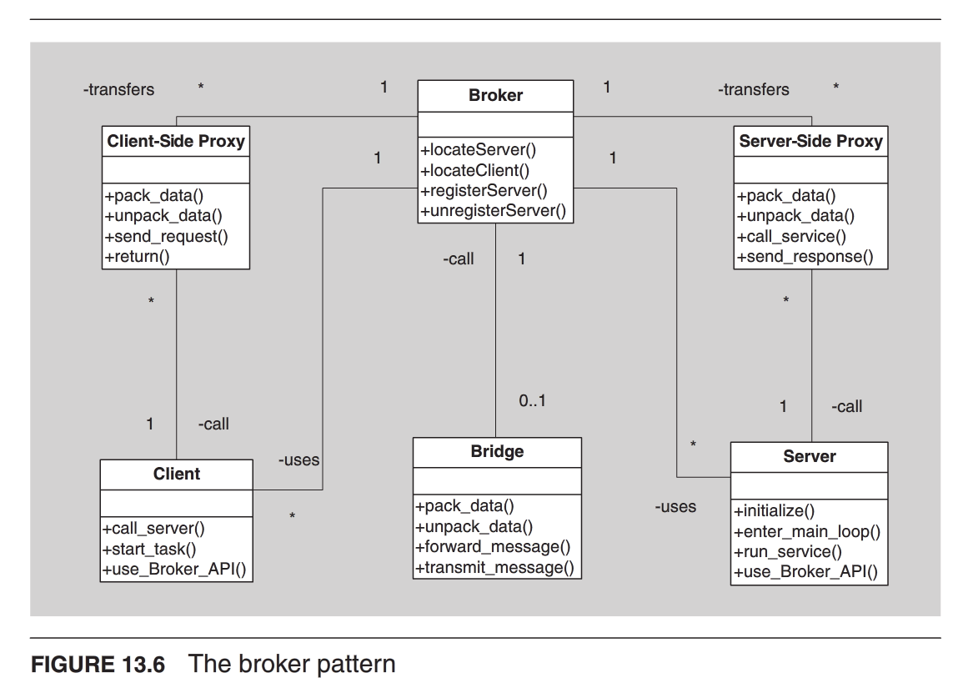
Component-and-Connector Patterns
Broker Pattern
Context: implementing systems with collaborative services: interoperation, connection, information exchange, and service availability.
Problem: How to structure distributed software so that service users do not need to know the nature and location of service providers, to make it easy to dynamically change the bindings between users and providers.
Solution

Slide 10
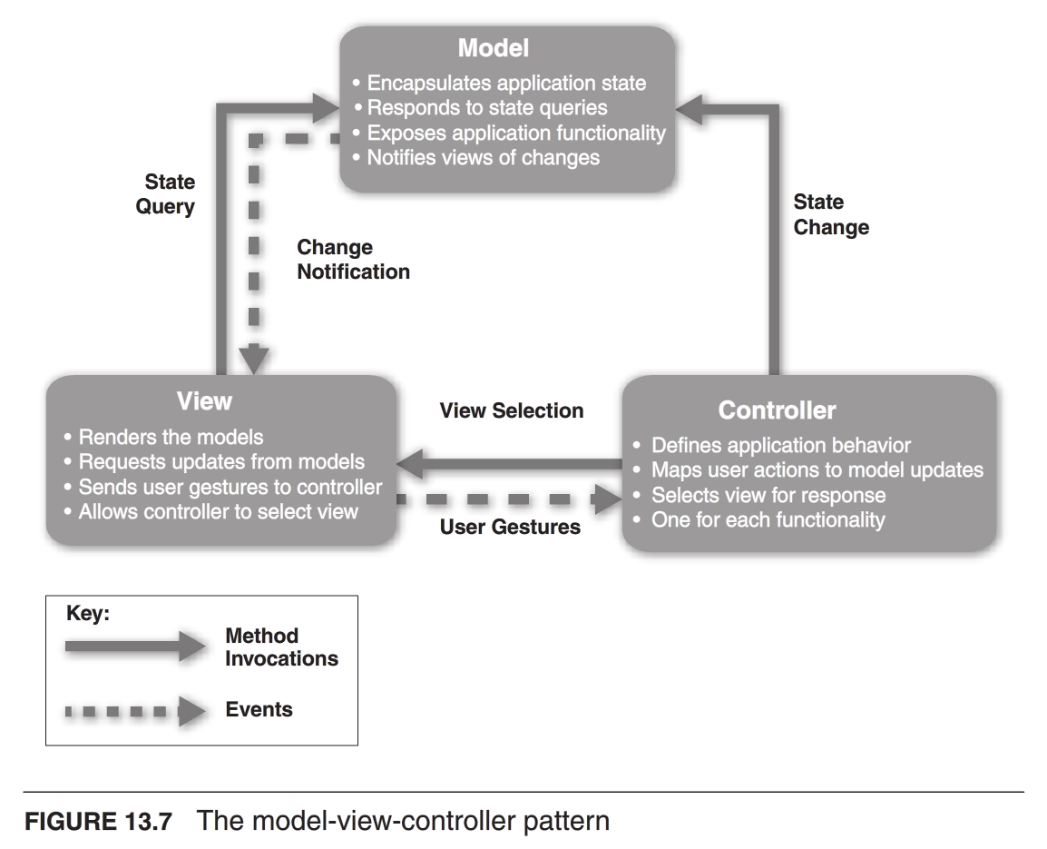
Component-and-Connector Patterns
Model-View-Controller (MVC) Pattern
Context: for interactive GUI based systems, to keep modifications to the user interface separate from the rest of the system, and support multiple or alternative views of computing results or current state of data.
Problem:
How can user interface functionality ne kept separate from application functionality and still be responsive to user input, or changes in the underlying application’s data?
How can multiple views of user interface be created, maintained, and coordinated when the underlying application data changes?
Solution

Slide 11
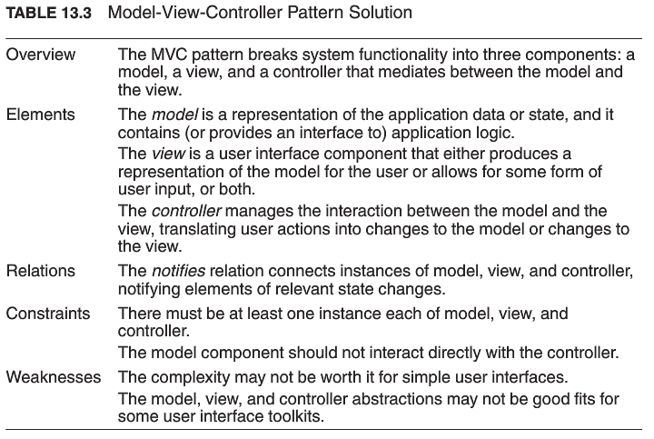
Component-and-Connector Patterns
Model-View-Controller (MVC) Pattern
Solution

Slide 12
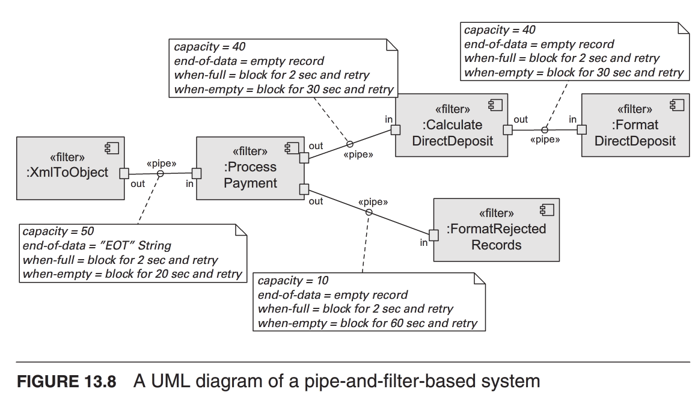
Component-and-Connector Patterns
Pipe-and-Filter Pattern
Context: transform streams of data items from input to output, using reusable components.
Problem: divide a system into reusable, loosely coupled components with simple, generic interaction mechanisms with flexible and dynamic combination of such reusable components, also support parallel executions of components
Solution

Slide 13
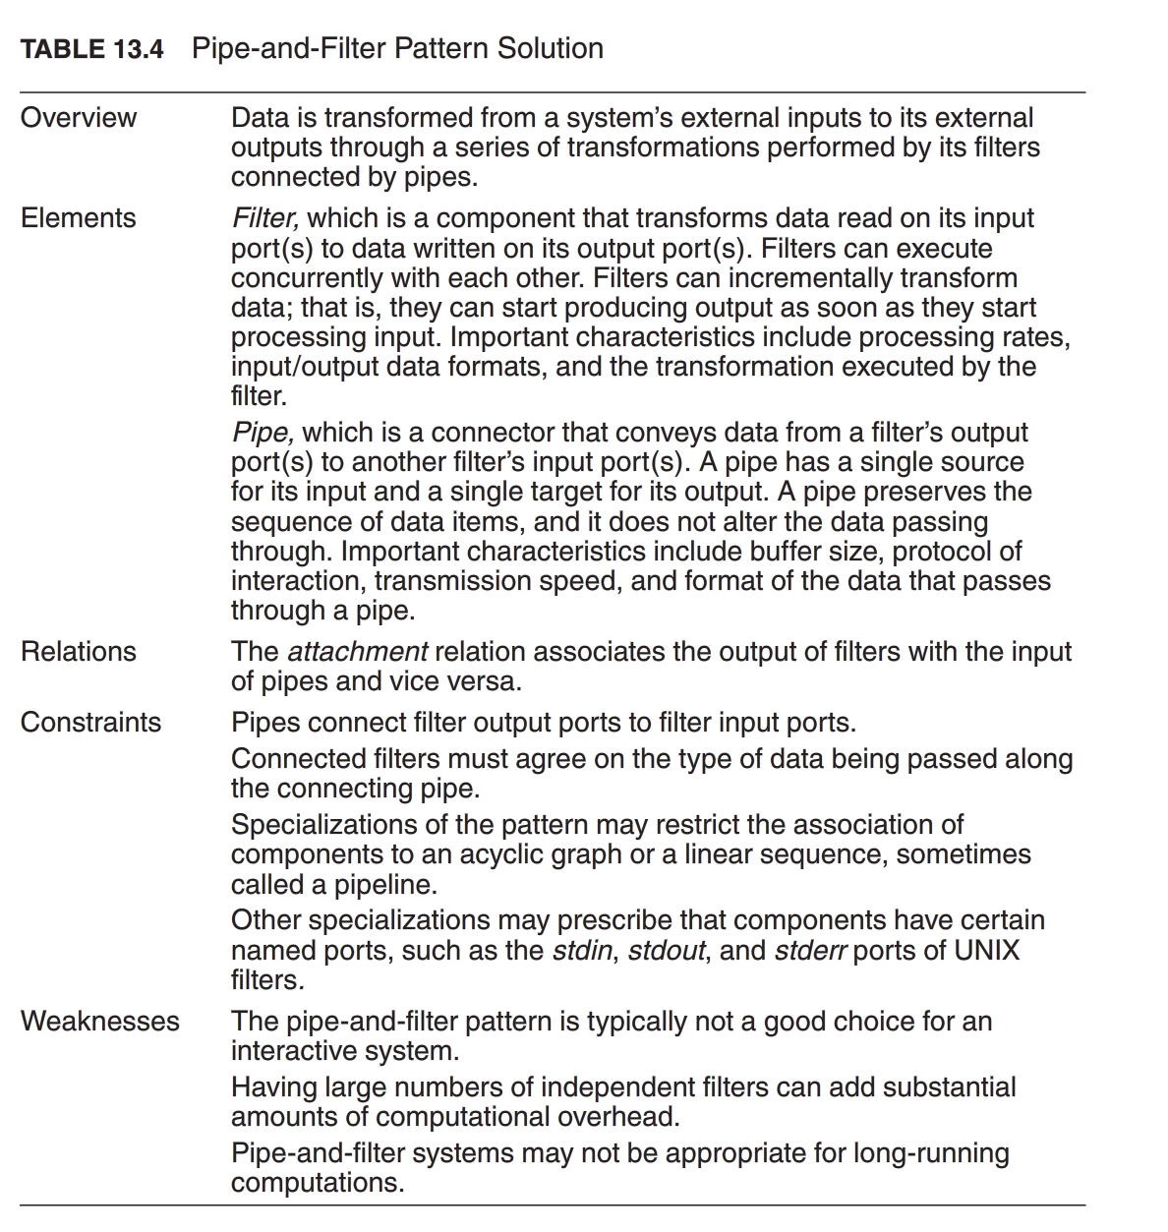
Component-and-Connector Patterns
Pipe-and-Filter Pattern
Solution

Slide 14
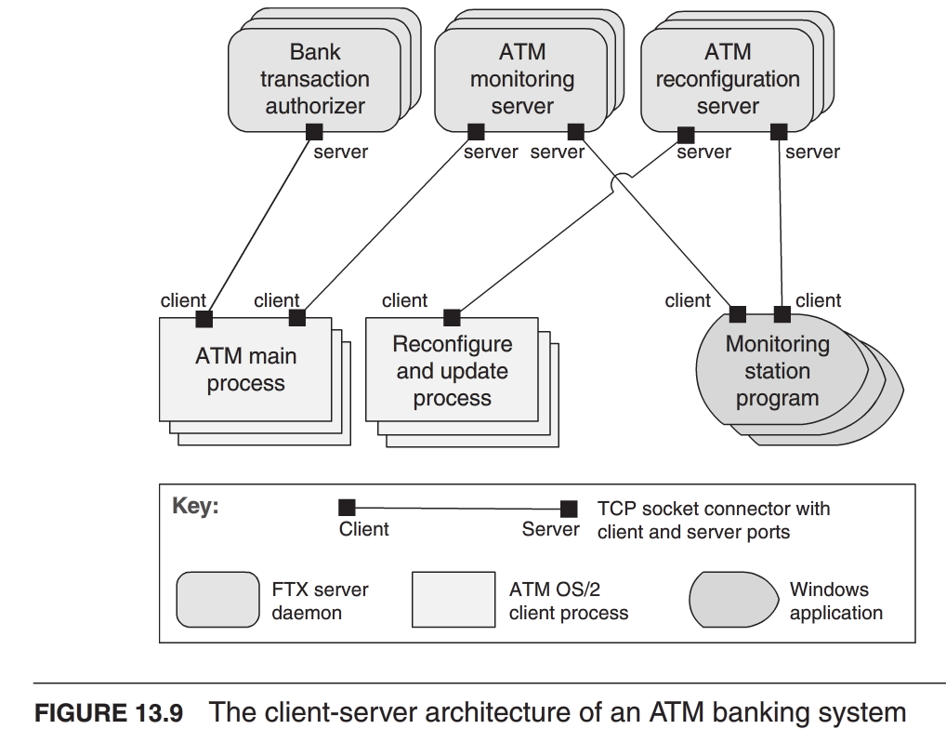
Component-and-Connector Patterns
Client-Server Pattern
Context: There are shared resources and services that large numbers of distributed clients wish to access, and for which we wish to control access or quality of service.
Problem:
for modifiability and reuse, factor out common services and modify them in a single location or small number of locations.
for scalability and availability, centralize the control of these resources and services while distributing the resources themselves across multiple physical servers.
Solution

Slide 15
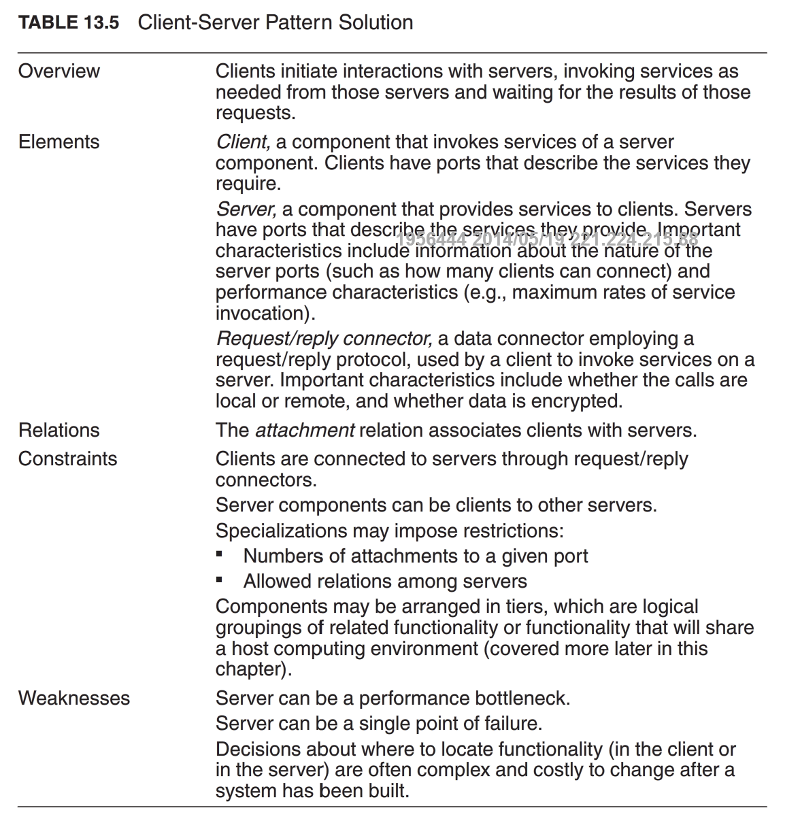
Component-and-Connector Patterns
Client-Server Pattern
Solution

Slide 16
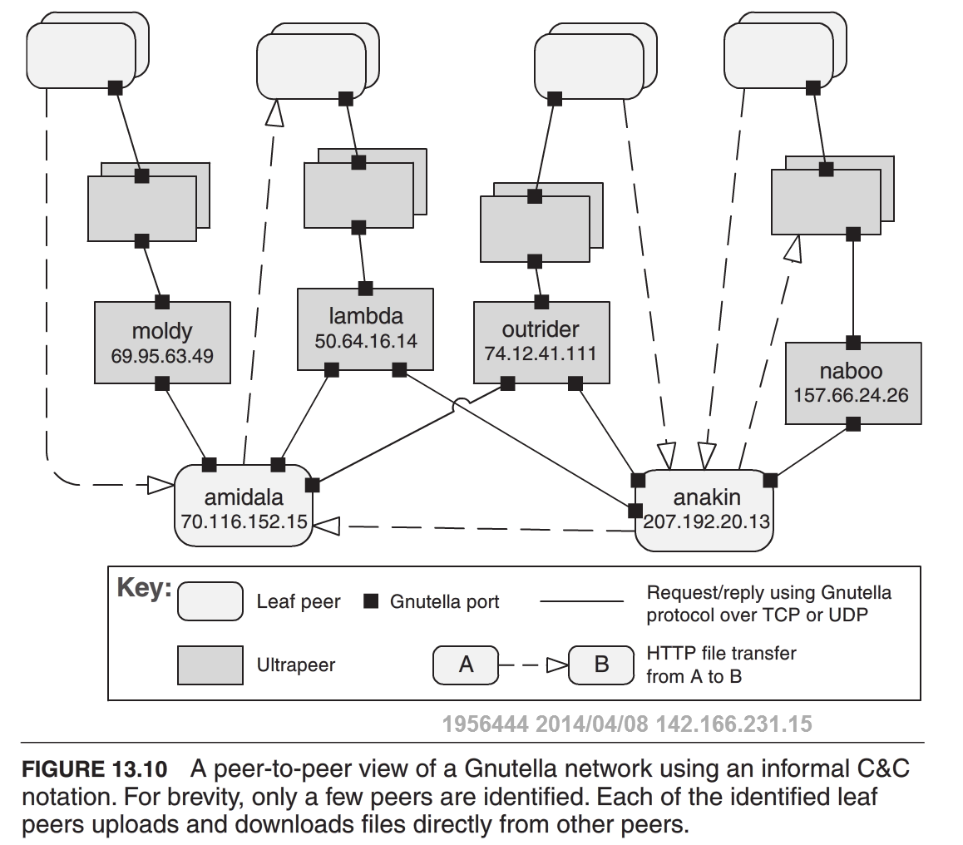
Component-and-Connector Patterns
Peer-to-Peer Pattern
Context: Distributed computing entities with independent resources need to cooperate and collaborate to provide a service to a distributed community of users.
Problem: How can a set of “equal” distributed computing entities be connected to each other via a common protocol, so that they can organize and share their services with high availability and scalability?
Solution

Slide 17
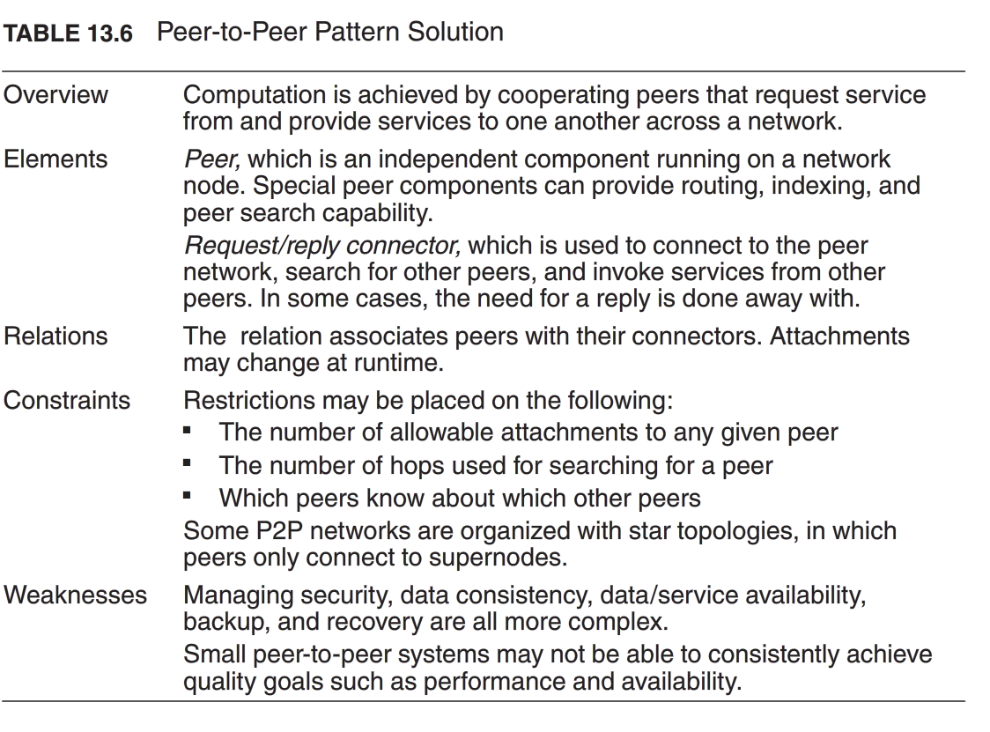
Component-and-Connector Patterns
Peer-to-Peer Pattern
Solution

Slide 18
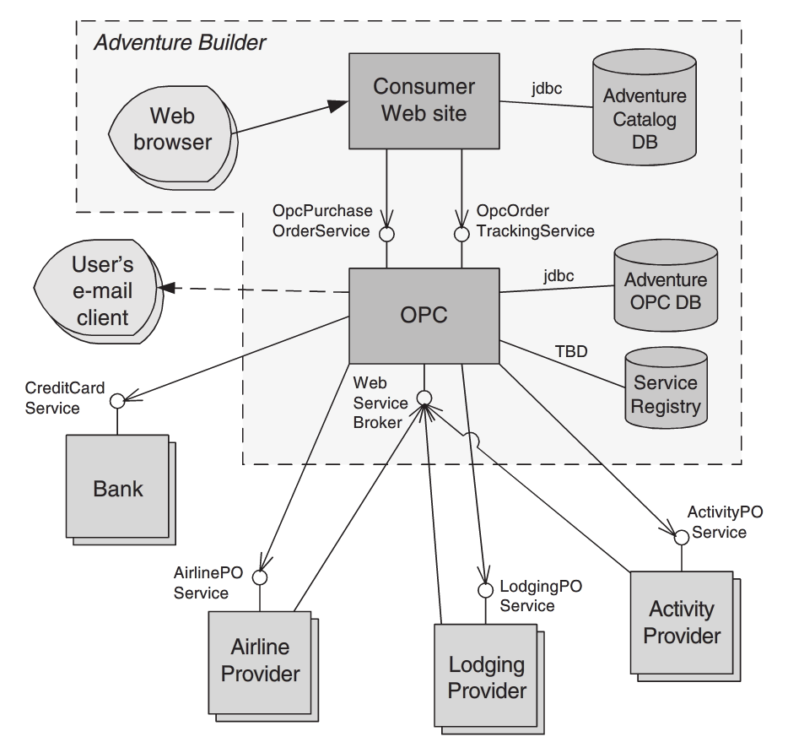
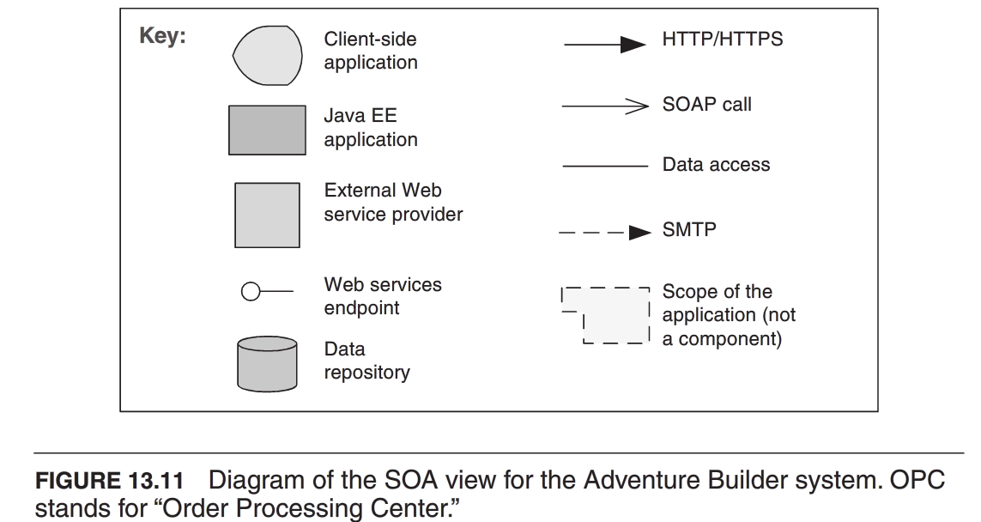
Component-and-Connector Patterns
Service-Oriented Architecture Pattern
Context: A number of services are offered (and described) by service providers and consumed by service consumers. Service consumers need to be able to understand and use these services without any detailed knowledge of their implementation.
Problem:
To support interoperability of distributed components running on different platforms and written in different implementation languages, provided by different organizations, and distributed across the internet.
To locate services and combine (and dynamically recombine) them into meaningful coalitions while achieving reasonable performance, security, and availability.
Solution

Slide 19
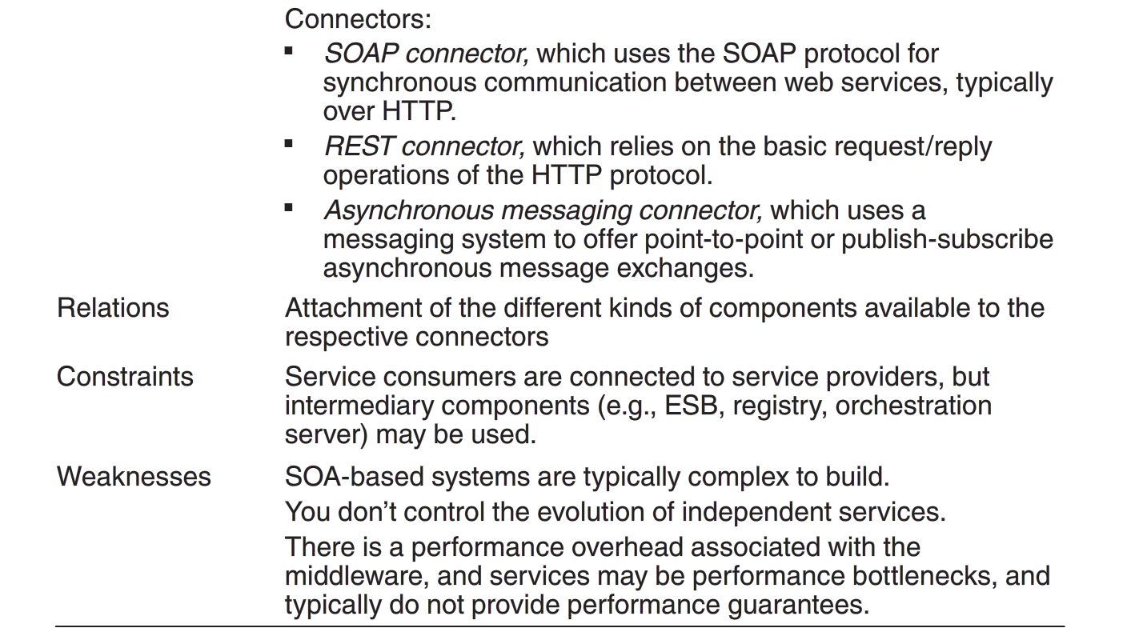
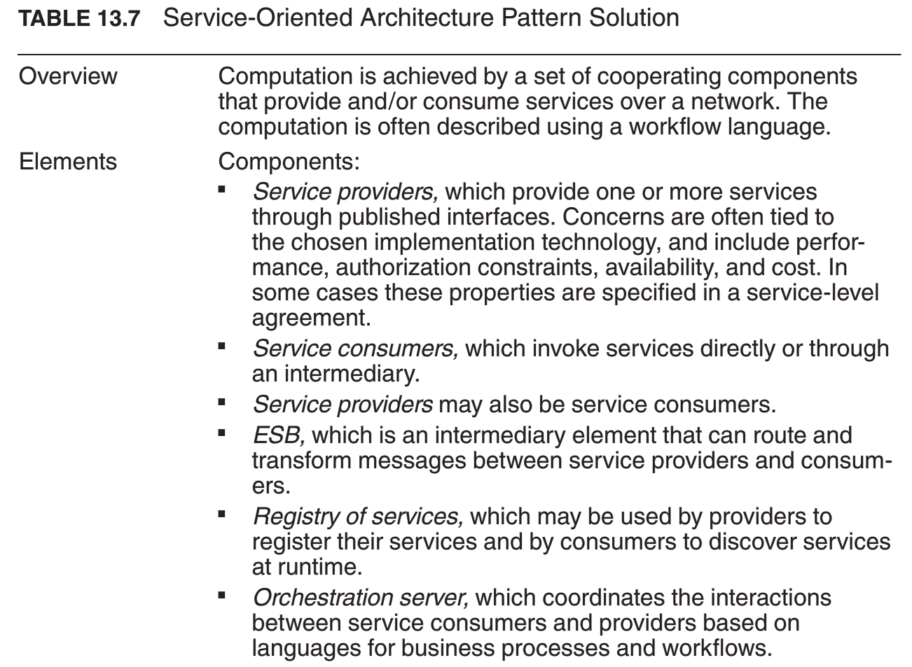
Component-and-Connector Patterns
Service-Oriented Architecture Pattern
Solution

Slide 20
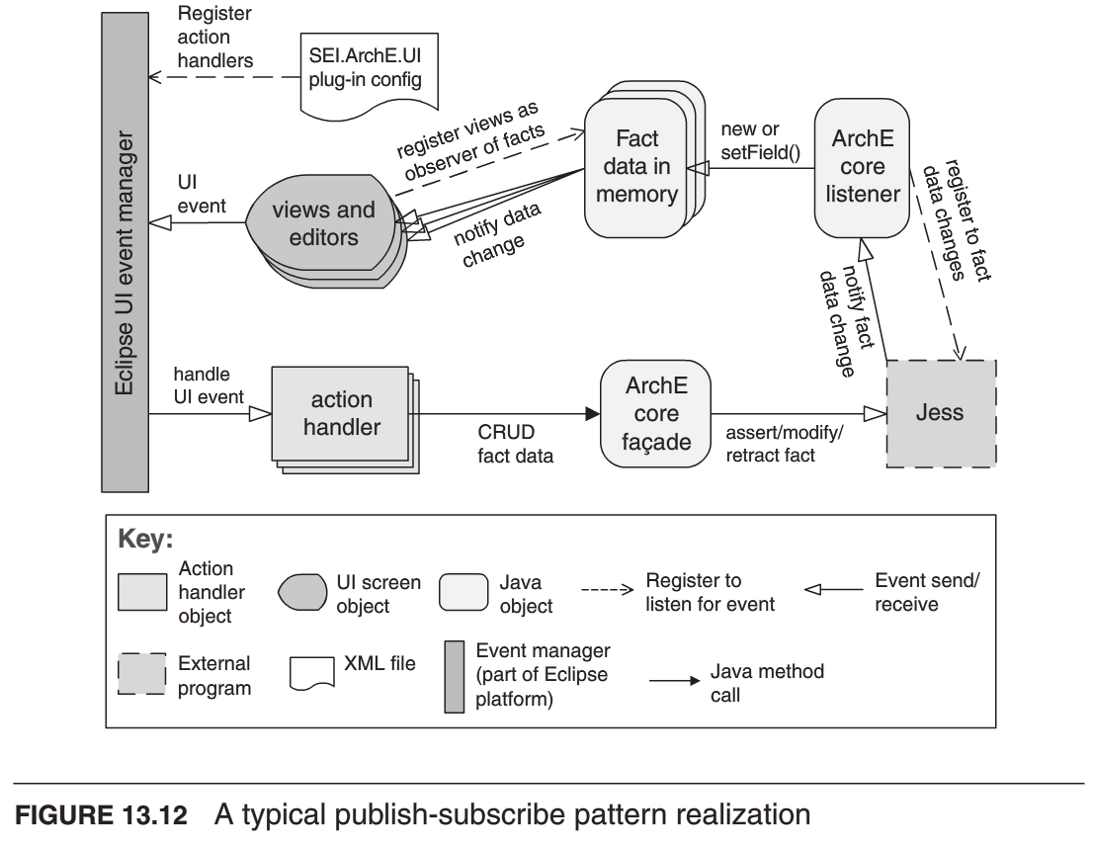
Component-and-Connector Patterns
Publish-Subscript Pattern
Context: There are a number of independent producers and consumers of data that must interact. The precise number and nature of the data producers and consumers are not predetermined or fixed, nor is the data that they share.
Problem: To create integration mechanisms that support the ability to transmit messages among the producers and consumers in such a way that they are unaware if each other’s identity, or potentially even their existence.
Solution

Slide 21
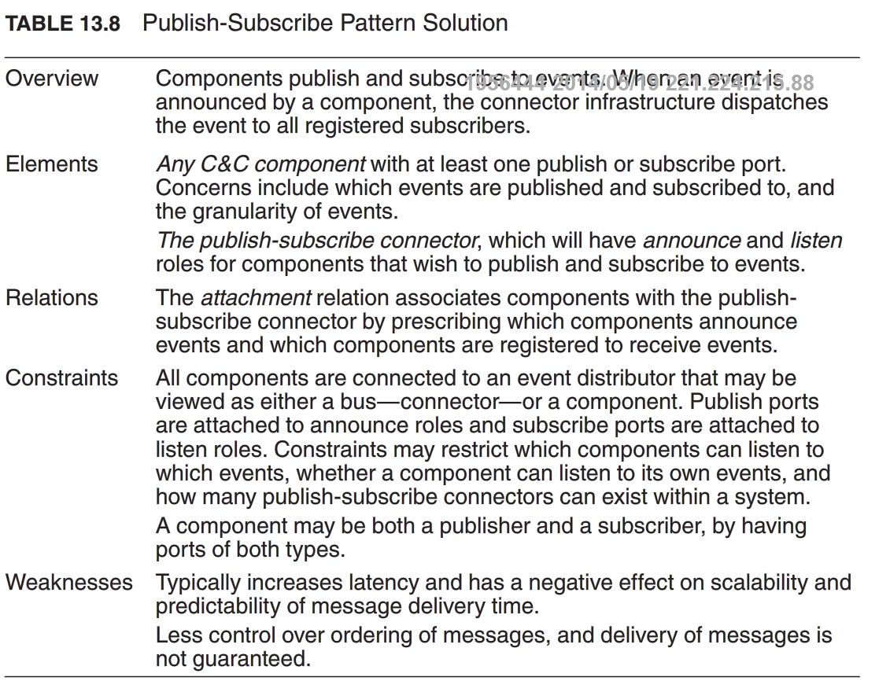
Component-and-Connector Patterns
Publish-Subscript Pattern
Solution

Slide 22
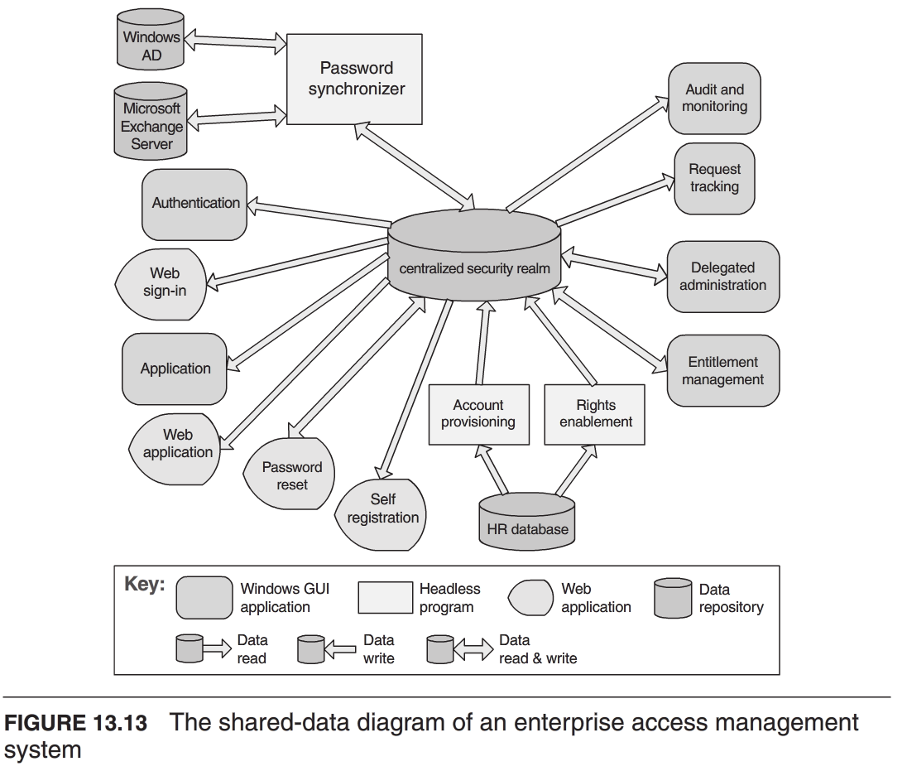
Component-and-Connector Patterns
Shared-Data Pattern
Context: Various computing components need to share and manipulate large amounts of data. This data does not belong solely to any one of those components.
Problem: To store and manipulate persistent data that is accessed by multiple independent components.
Solution

Slide 23
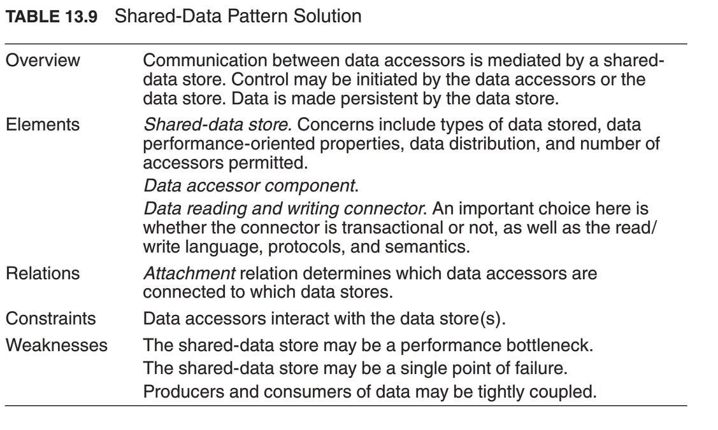
Component-and-Connector Patterns
Shared-Data Pattern
Context: Various computing components need to share and manipulate large amounts of data. This data does not belong solely to any one of those components.
Problem: To store and manipulate persistent data that is accessed by multiple independent components.
Solution

Slide 24
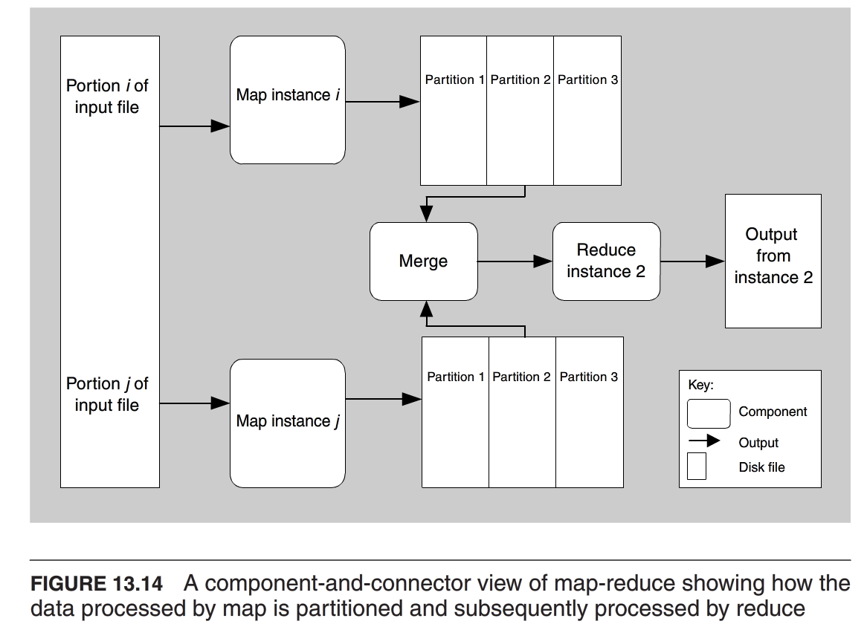
Allocation/C&C Patterns
Map-Reduce Pattern
Context: Programs for analysis of big data should be easy to write, run efficiently, and resilient with respect to hardware failure.
Problem: To efficiently perform a distributed and parallel sort of a large data set and provide a simple means for programmer to specify the analysis to be done.
Solution

Slide 25
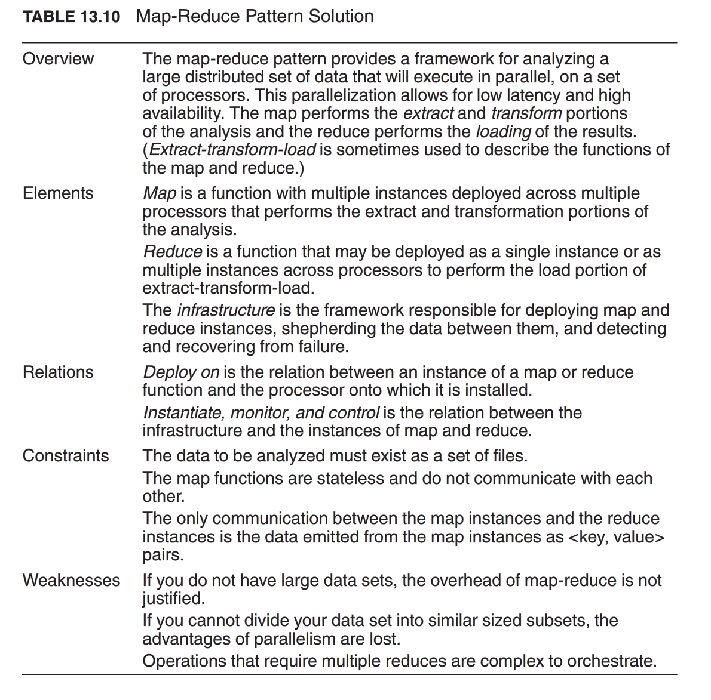
Allocation/C&C Patterns
Map-Reduce Pattern
Solution

Slide 26
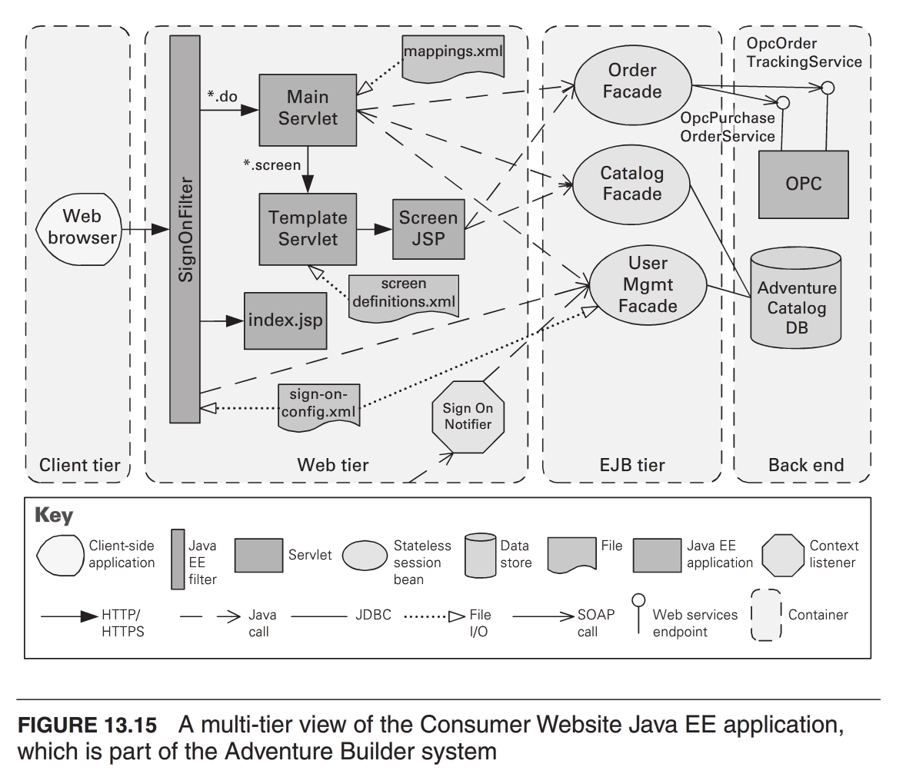
Allocation/C&C Patterns
Multi-Tier Pattern
Context: In a distributed deployment, to distribute a system’s infrastructure into distinct sunsets, for operational or business reasons.
Problem: To split the system into a number of computationally independent execution structures (groups of software and hardware) connected by some communication media, to provide specific environments optimal for operational requirements and resource usage.
Solution

Slide 27
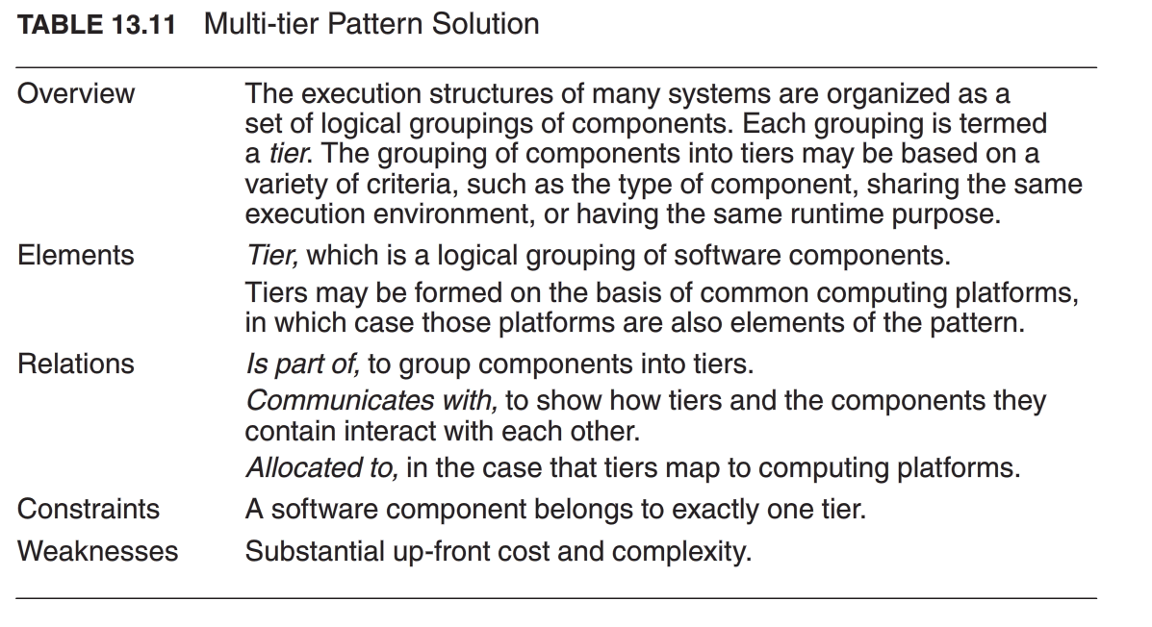
Allocation/C&C Patterns
Multi-Tier Pattern
Context: In a distributed deployment, to distribute a system’s infrastructure into distinct sunsets, for operational or business reasons.
Problem: To split the system into a number of computationally independent execution structures (groups of software and hardware) connected by some communication media, to provide specific environments optimal for operational requirements and resource usage.
Solution

Slide 28
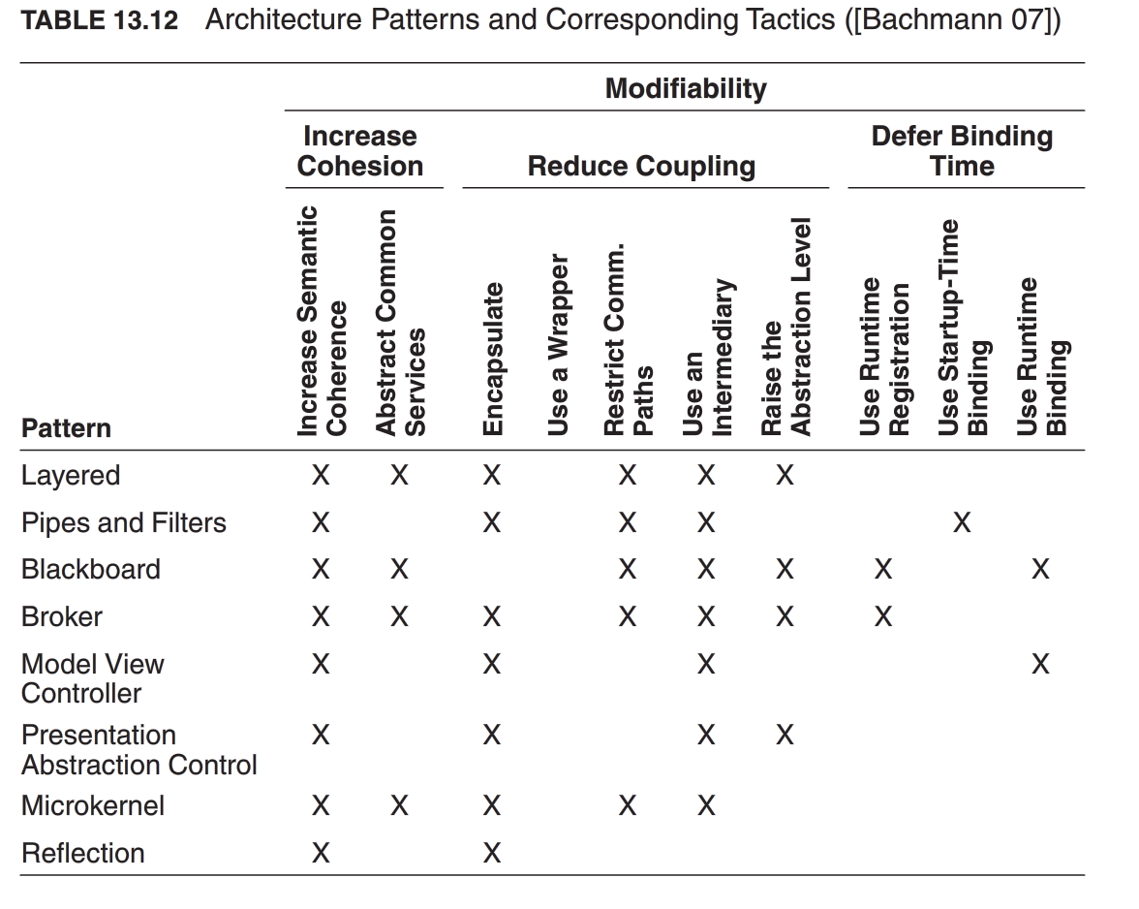
Relationships between Tactics and Patterns

